Slide 1
Data-Binding

Slide 2
What is Data Binding
Data binding is one of the most powerful features of software development technologies. Data binding is the connection bridge between View and the business logic (View Model) of the application. The following are the ways of doing data banding with Blazor.
One-way Data Binding
Two-way Data Binding
Event Binding

Slide 3
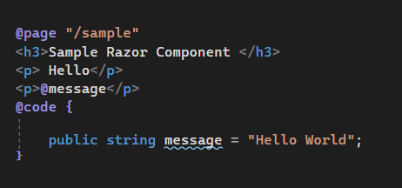
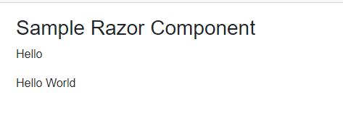
One –Way Data Binding
In one-way binding, we need to pass property or variable name along with @, i.e., @Title (here Title is either the property or variable)
One-way data binding is also known as an interpolation in other frameworks, such as Angular. It is very similar to Razor and also it will be quite straightforward.

Slide 4
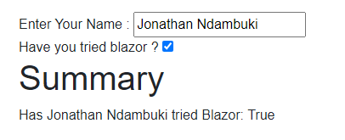
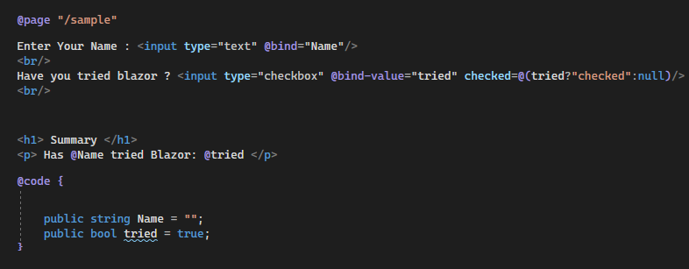
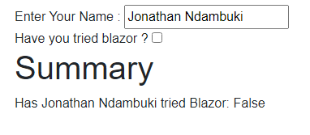
Two-way Data Binding
Two-way data binding can be achieved by using the "bind" attribute. The current version of Blazor supports the following types for two-way binding.
string
int
DateTime
Enum
bool

Slide 5
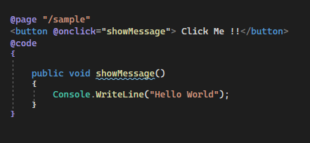

Event Binding
Event binding is done by using function name along with @ i.e. @ButtonClicked (here ButtonClicked is function name).

